Slide 1
Mongo DB

Slide 2
NOSQL databases
Alternative to sql databases
Store documents (JSON) in a db, instead of tables with rows and columns
Works really well with js

Slide 3
What is Mongo DB
Document-oriented NoSQL database
Works on concept of collection and document.
Documents consist of key-value pairs which are the basic unit of data in MongoDB.
Mongo is the ‘M’ in MERN or MEAN stack

Slide 4
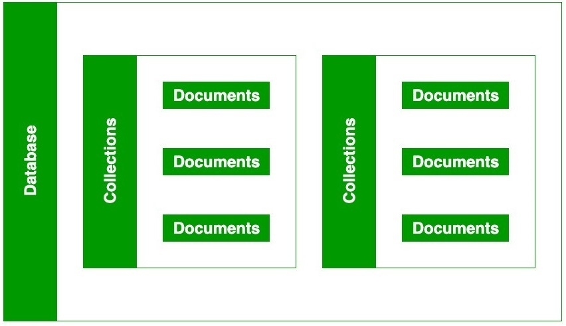
How It Works

Slide 5
Features of MongoDB
Scalability
Schema-less Database
High Performance

Slide 6
Storing json
[
{
Item: ‘walk’
}
{
Item: ‘eat’
}
]

Slide 7
Client (Browser)
Server (Node)
({Mongoose})
MongoDB

